Slide 1
Before Starting
The Why
The What
The How

Slide 2
The Problem Statement
Learning in the age of AI
Our own newsletter
Time Constraints

Slide 3
Step 1 - The Structure
Introduction
Top X posts
Big Story of the Week
Closing notes
3-5 Quick Updates
Top Research Papers
Top Github Repos
1 Quick Tutorial
Top AI products

Slide 4
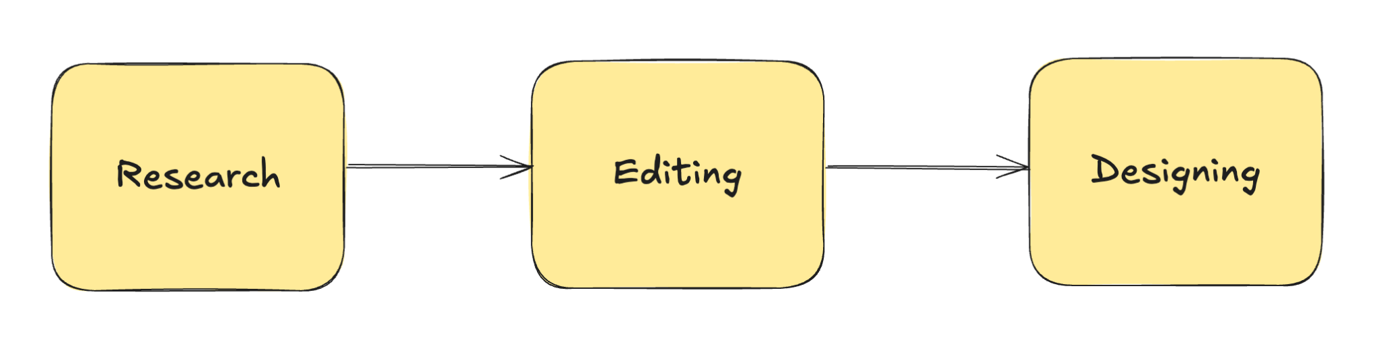
Step 2 - Defining the Process

Slide 5

Step 3 - Deciding the Tools
The Main AI
The Tools
Github
Web Search
Google Drive
Arxiv
Gmail
Product Hunt

Slide 6
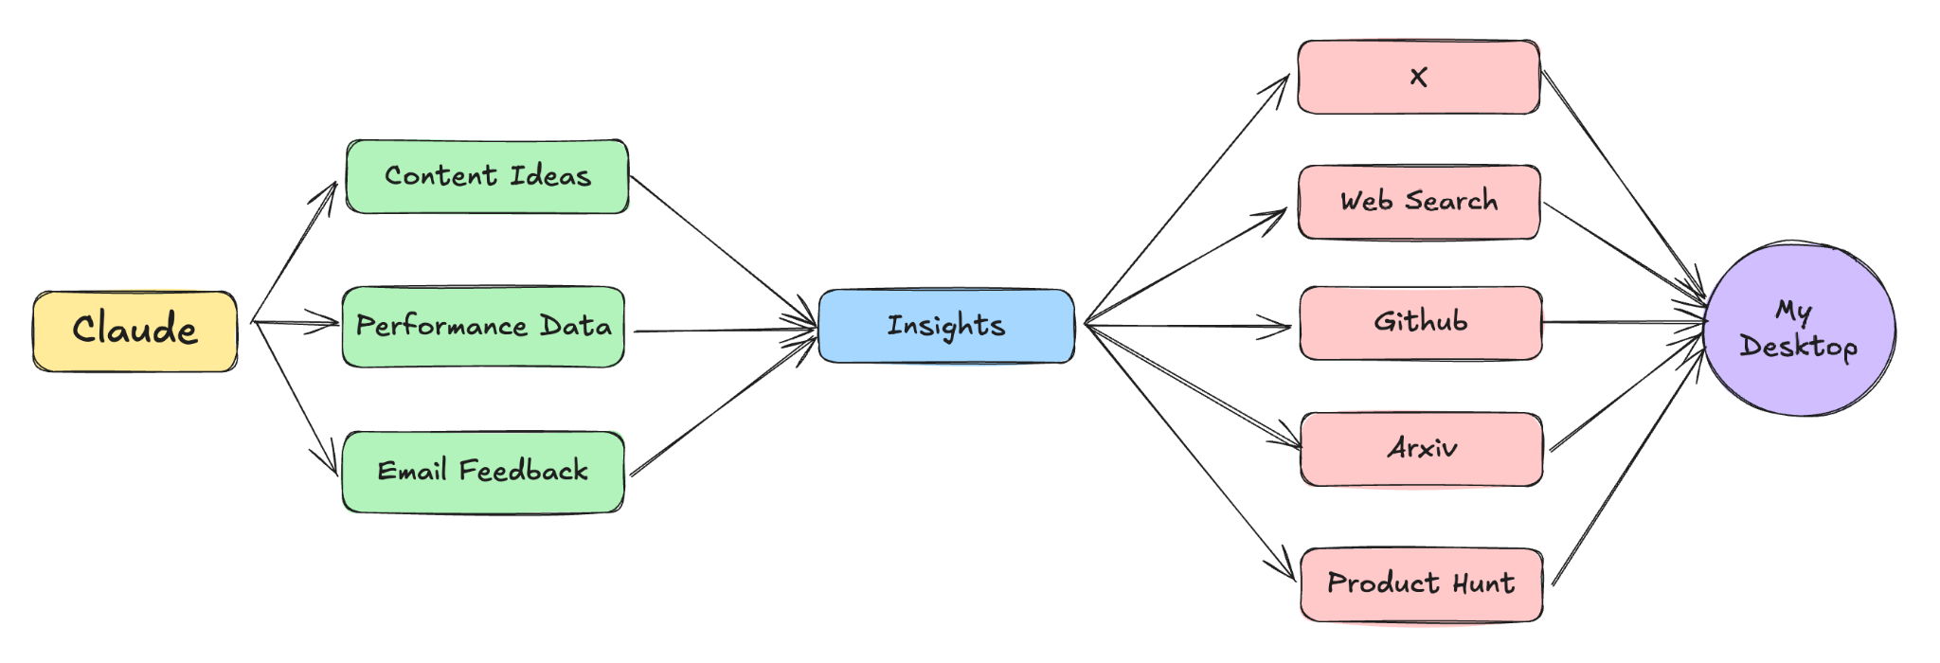
Step 4 - The Research Phase

Slide 7
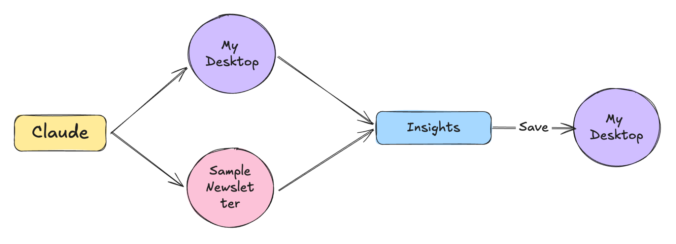
Step 5 - Editing Phase

Slide 8
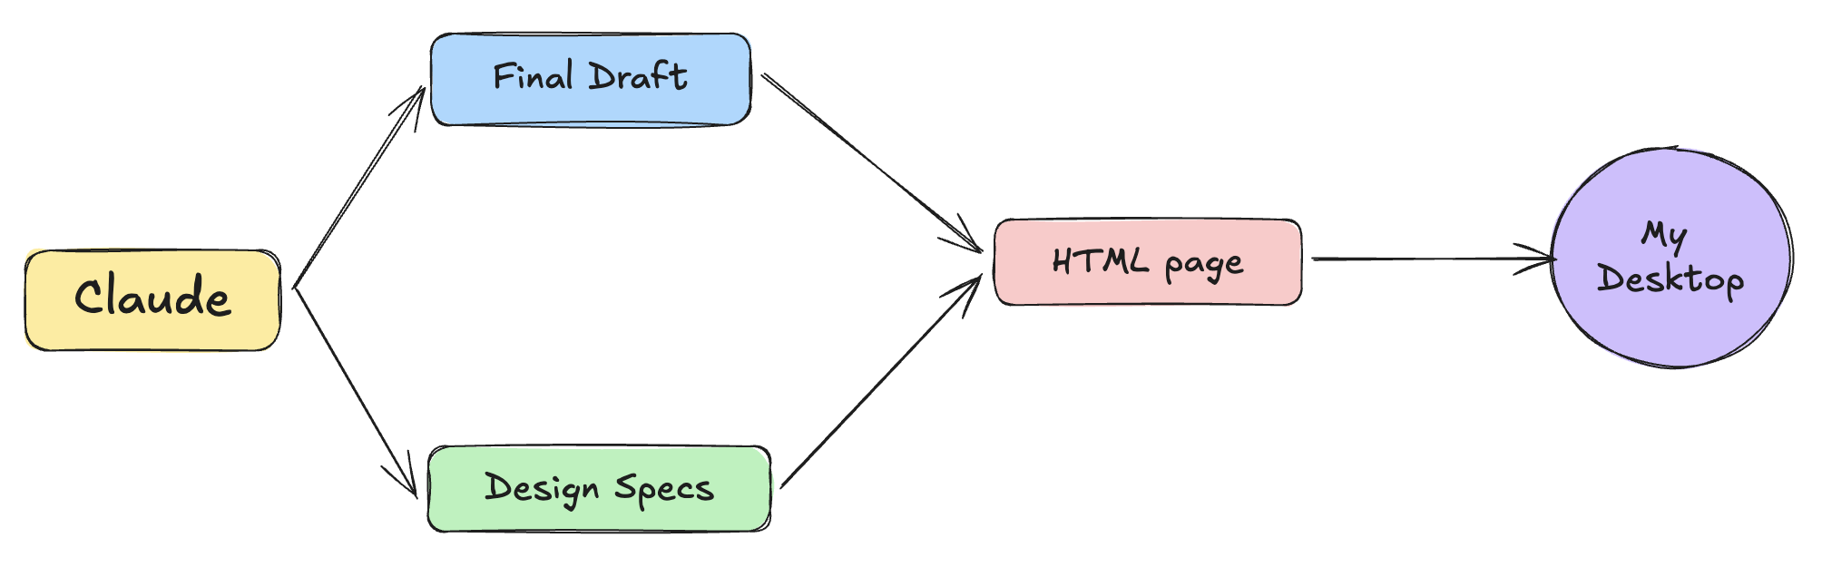
Step 6 - Designing Phase

Slide 9
PART 1
THE WHY

Slide 10

The Arrival of LLMs
ChatGPT was launched on Nov 30 2022
It crossed 1 Million users in 5 days
Then it crossed 100 Million users in 2 months
Not another software launch.

Slide 11
Waves of Adoption
Wave 1 - Pure Wonder
Explain Quantum Physics from a cat’s perspective
What would happen if gravity worked backwards
Write a song about pizza in the style of Shakespeare
Impact - Social Media Exploded

Slide 12
Waves of Adoption
Wave 2 - Professional Adoption
Lawyers: "Summarize this 50-page contract."
Developers: "Debug this Python function."
Teachers: "Create a lesson plan about photosynthesis."
Impact - Individual productivity boom

Slide 13
Waves of Adoption
Wave 3 - The API Revolution
Copilot across Word, Excel, PowerPoint, and Outlook
AI in Gmail, Docs, Sheets, and Drive
New AI-first tools like Cursor, Perplexity emerged
Impact - AI became more accessible

Slide 14
The Problem of Fragmentation
AI in notion couldn't talk to AI in Slack
VS Code coding assistant knew nothing about discussions in MS teams
People found themselves living in multiple AI worlds
Users were juggling between multiple AI assistants

Slide 15
The Vision vs The Reality
They wanted one unified AI partner that can understand their work
A unified tool that can solve any problem related to their work
Users never wanted 5 different AI tools
But there was a big problem in building a unified AI
The problem of Context

Slide 16
What is Context
Context is everything an AI can "see" when it generates a response.
More formally, Context refers to the information(conversation history, external docs etc) that the LLM uses to generate a response.
For e.g. while chatting with ChatGPT, the past messages forms the context.

Slide 17






Example - Software Engg.

Slide 18
Software Engg. workflow with AI
Context is scattered

Slide 19
The Copy-Paste Hell
Need to paste thousands of line to ask one simple question
Developers have become Human APIs
Context Assembly Time > Development Time
Managing what the AI remembers
Scaling problems

Slide 20
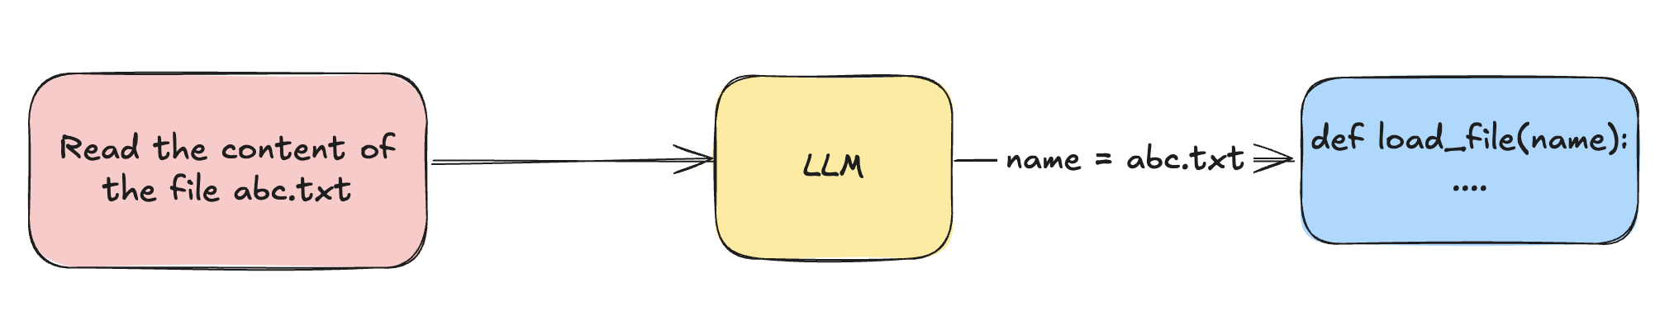
The Solution - Function Calling
OpenAI introduced function calling in mid 2023
Function Calling is a way using which LLMs can call ext functions

Slide 21
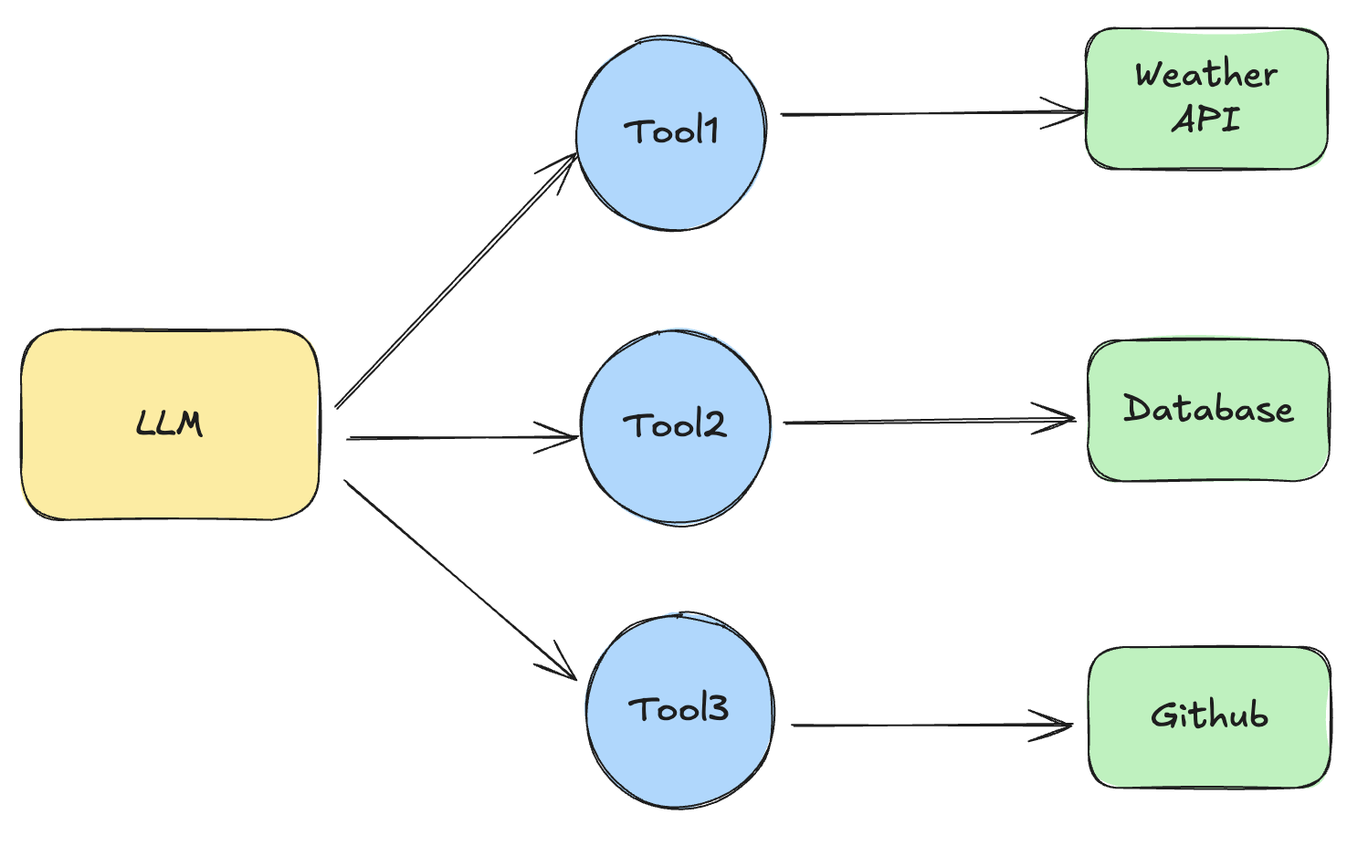
The Rise of Tools

Slide 22
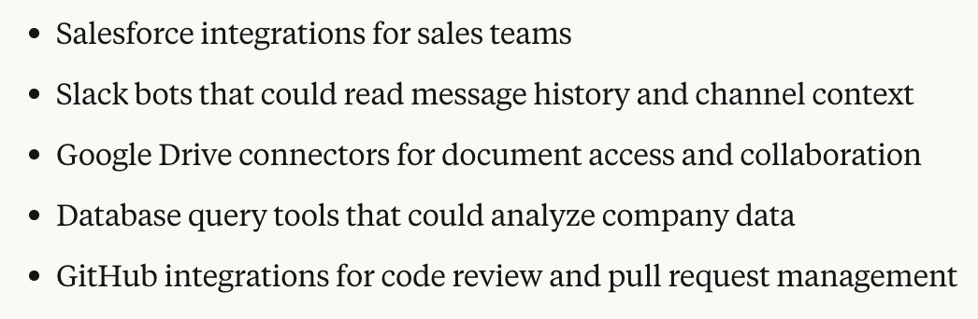
Implication of Tools

Slide 23
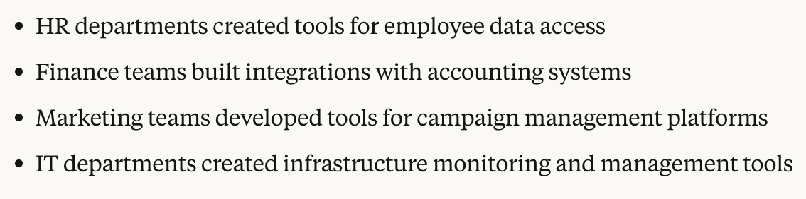
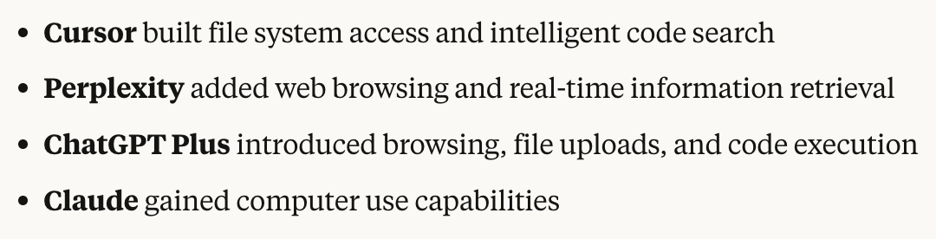
Implication of Tools

Slide 24
The New Scenario
Tool
Tool
Tool
Tool
Tool

Slide 25
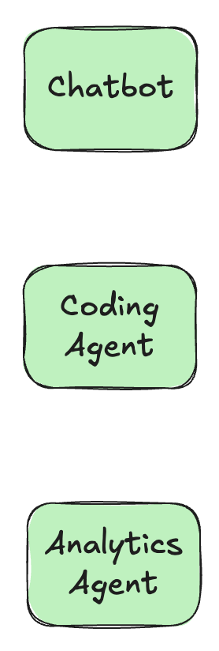
Problem with Tools
Integration Problem
N * M
Development Nightmare
Diff authentication methods
Diff data formats and API patterns
Diff error handling

Slide 26
Problem with Tools
Maintenance Problem
Security fragmentation
Cost and time wastage

Slide 27


Overview of the Problem
Every AI tool was building its own way to call every API.

Slide 28
The Solution
Github builds an integration that can be used by any AI Tool

Slide 29
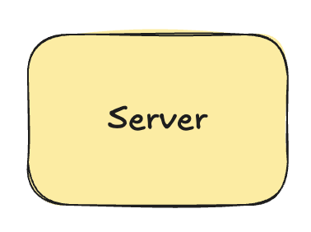
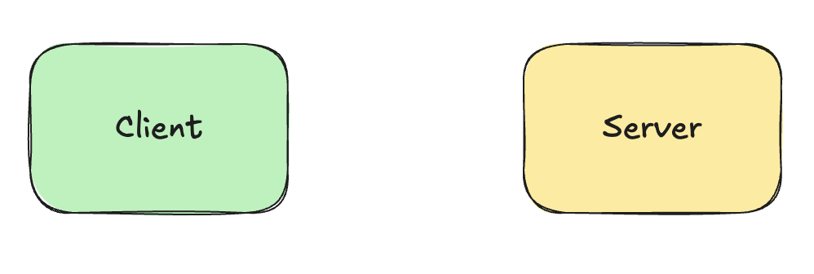
Enter MCP
MCP Server SDK
MCP Client SDK

Slide 30
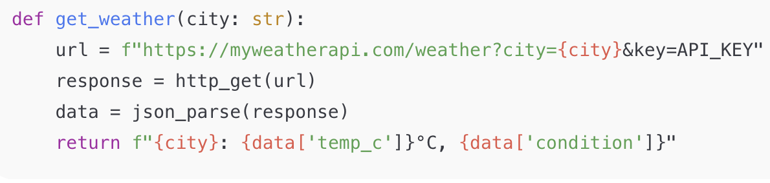
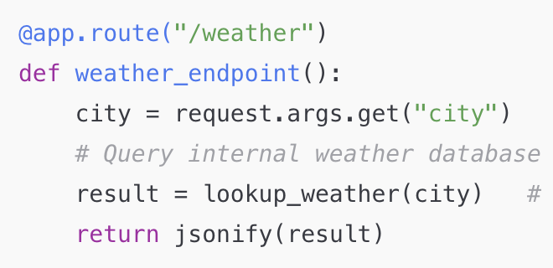
MCP vs Function/Tool Calling
Client
Server

Slide 31
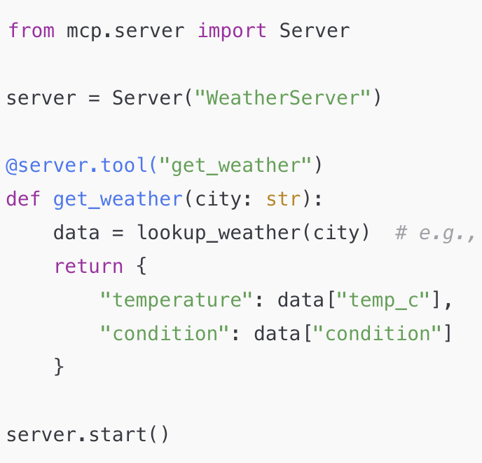
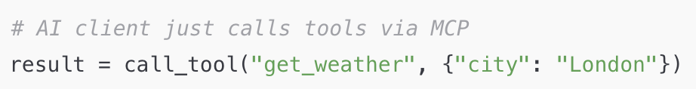
MCP vs API
Server
Client

Slide 32
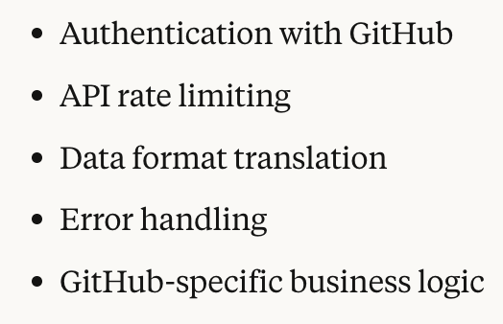
Server does the Heavy Lifting
The Client has to just connect to the server using the same language

Slide 33
Benefits
N clients and M servers = M + N integrations
No maintenance overhead
Reduced cost and time
Better security

Slide 34
MCP Ecosystem
More AI Chatbots supporting MCP → More valuable for services to build MCP servers
More MCP servers available → More valuable for AI tools to support MCP
More adoption → More standardization → More ecosystem value
Not supporting MCP meant being cut off from the rapidly growing ecosystem

Slide 35
PART 2
THE WHAT

Slide 36





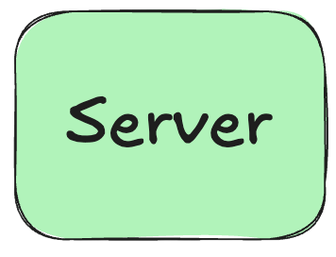
Architecture
Simplest Version
Are there any new commits on the github repo

Slide 37
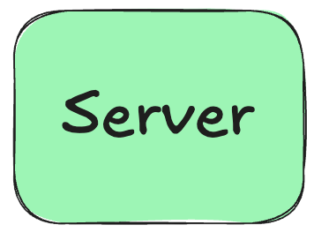


Architecture
Adding a Client

Slide 38
Benefits
Decoupling
Safety
Parallelism
Scalability

Slide 39
Architecture
Primitives
Things the server can offer to Host
Tools
Resources
Prompts

Slide 40
MCP Primitives
Tools - Actions the AI ask the server to perform.
Resources - Structured data sources that the AI can read
Prompts - Predefined prompt templates or instructions that the server offers to help shape the AI's behavior

Slide 41
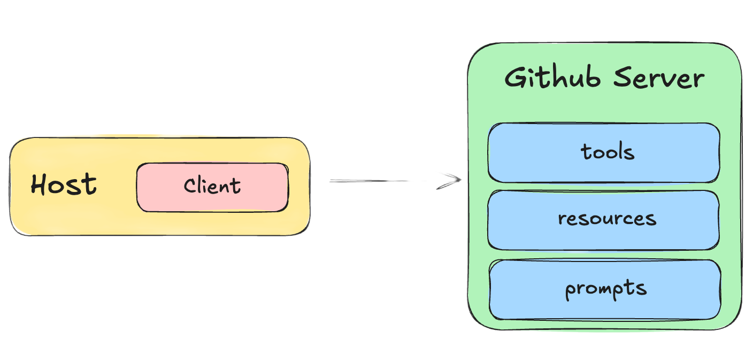
The Prompts Primitives
Create an issue for a bug:
the login button doesn’t work.
/create-issue

Slide 42
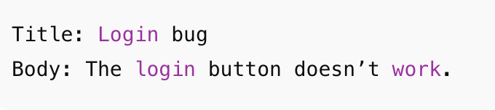
The Prompts Primitives
Too vague!

Slide 43
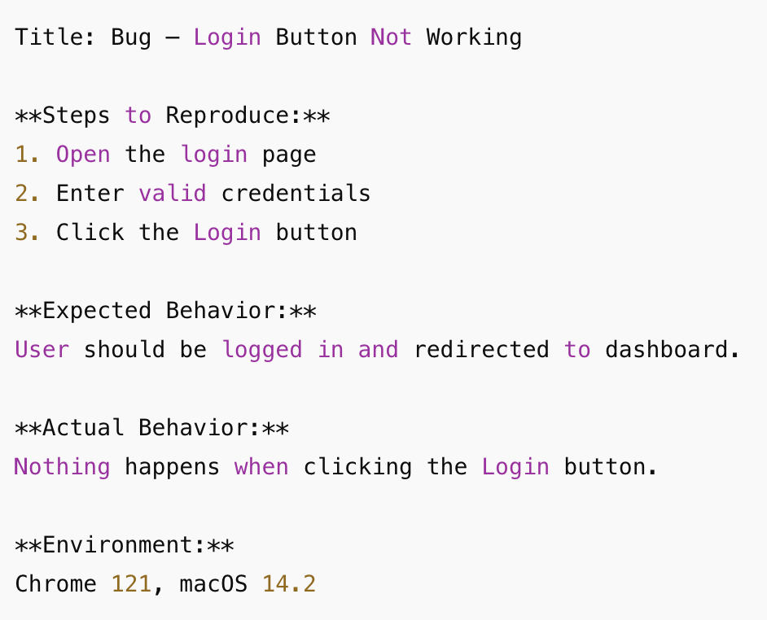
The Prompts Primitives
{
"name": "issue_report_prompt",
"description": "Write clear, detailed GitHub issues",
"messages": [{
"role": "system",
"content": "Always include: Title, Steps to Reproduce, Expected, Actual, Environment"}
}]
}

Slide 44
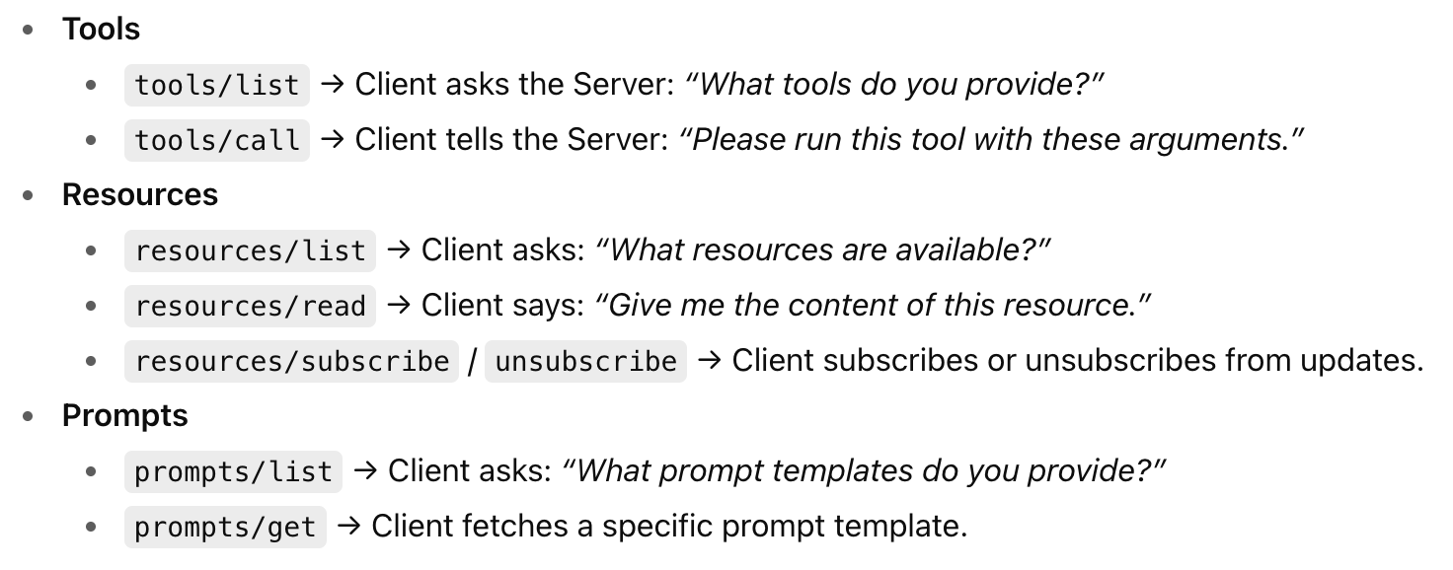
Primitives - Standard Operations

Slide 45
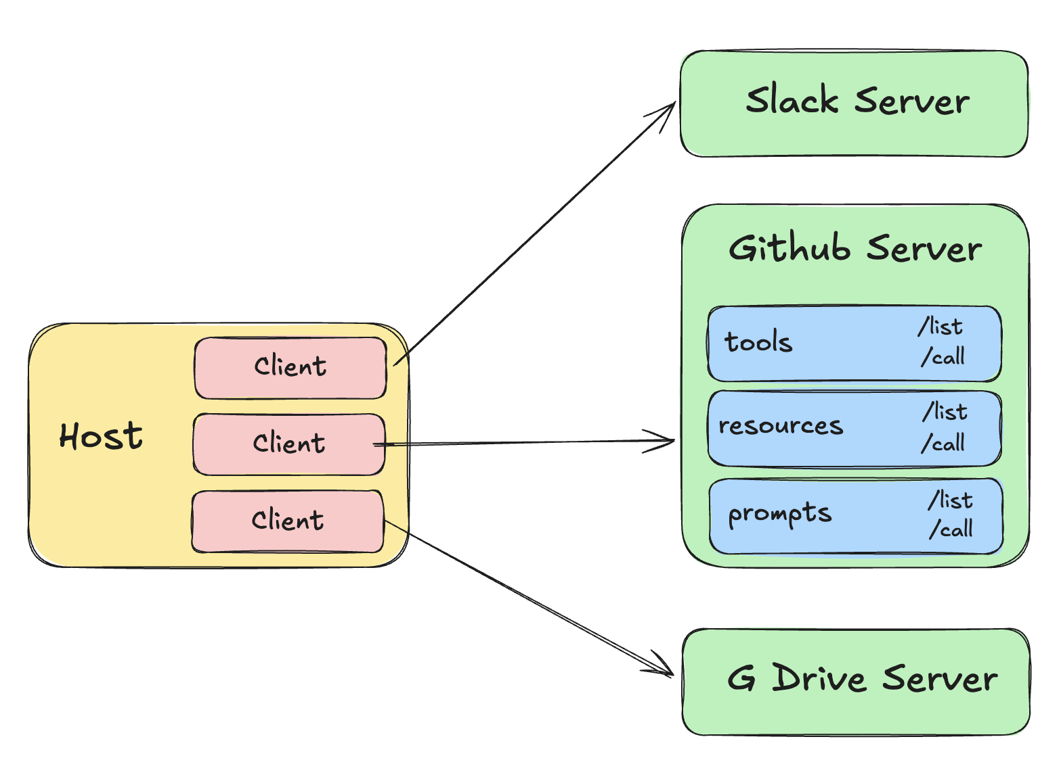
Summary till now!

Slide 46
MCP Data Layer
Data Layer - The data layer is the language and grammar of the MCP ecosystem that everyone agrees upon to communicate.
In MCP, JSON RPC 2.0 serves as the foundation of the data layer

Slide 47
JSON RPC 2.0
JSON-RPC stands for JavaScript Object Notation – Remote Procedure Call.
A Remote Procedure Call (RPC) allows a program to execute a function on another computer as if it were local, hiding the details of network communication and data transfer. This abstraction makes it easier to build distributed applications.
Instead of writing add(2, 3) locally, you send a request to the server saying “please run add with parameters 2 and 3.”

Slide 48
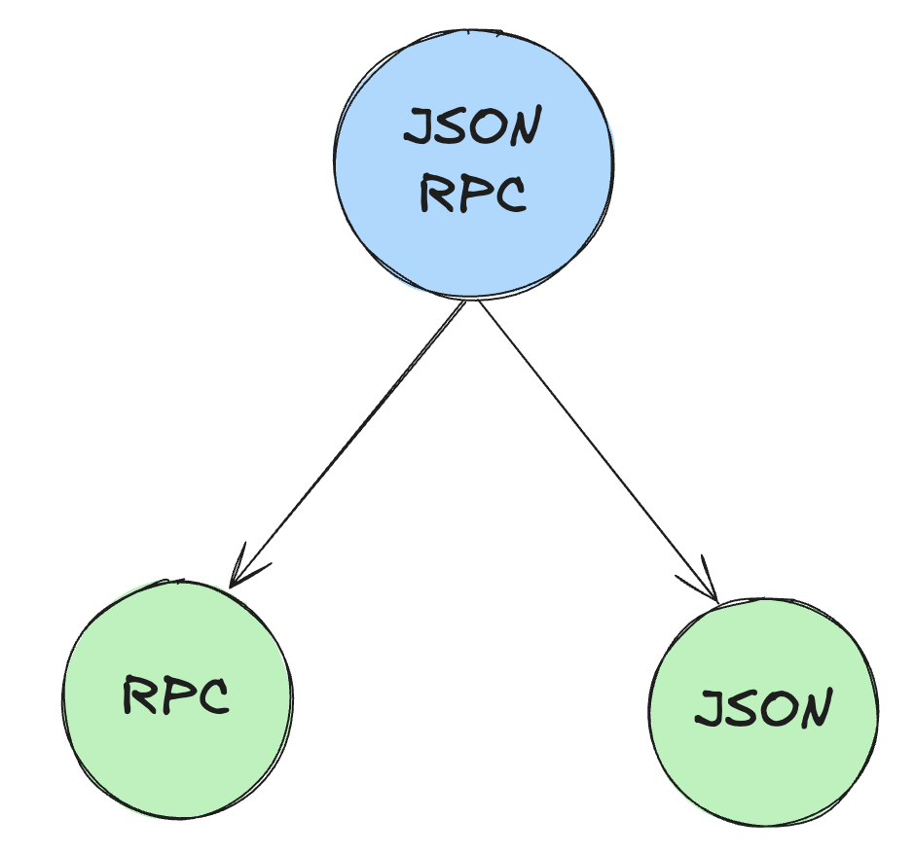
JSON RPC 2.0
JSON-RPC combines the concept of Remote Procedure Calls with the simplicity of JSON, allowing developers to structure RPC requests and responses in a standardized JSON format.

Slide 49
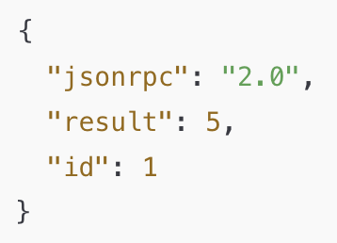
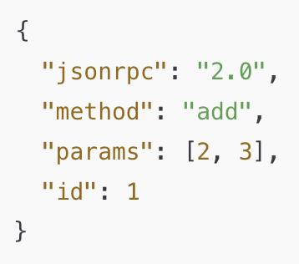
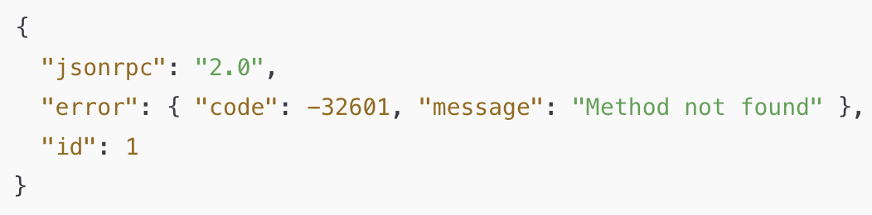
JSON RPC 2.0
Response Structure
Request Structure

Slide 50
Example Communication
Initial handshake
Calling a tool
Batching
Notification
Error Handling

Slide 51
Why JSON RPC for Data Layer?
It’s lightweight
Supports bi-directional communication
It is transport-agnostic
Supports batching
Supports notification

Slide 52
MCP Transport Layer
The Transport Layer is the mechanism that moves JSON-RPC messages between the Client and Server.
The choice of transport depends on the type of server.

Slide 53
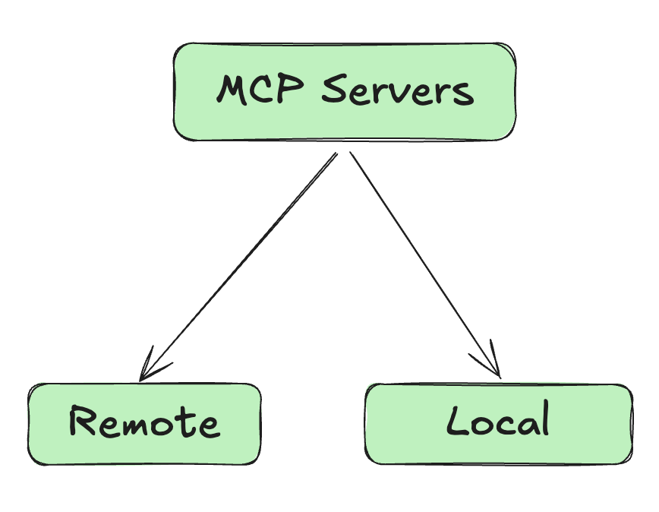
MCP - Types of Server
A local server is a program running on your own computer.
-> STDIO
A remote server is a program running on another computer (somewhere else on the network or internet) that you connect to over a network.
-> HTTP/SSE

Slide 54
Local Servers - STDIO
STDIO refers to the built-in streams every program has.
stdin (input the program reads)
stdout (output the program writes)
In MCP, these streams are used as transport layer between the client and server.

Slide 55
How does STDIO work?
The host launches the server as a subprocess on the same machine.
The host(client) writes JSON-RPC messages into the server’s STDIN
The server reads those messages, processes them, and writes back responses to it’s STDOUT

Slide 56
Benefits of the STDIO transport
Fast - data is passed directly between processes.
Secure - no open network port that could be attacked; communication is only local.
Simple → every language/runtime supports reading/writing from stdin/stdout. No extra libraries required.

Slide 57
Remote Servers - HTTP + SSE
Using HTTP allows the host to reach Servers running anywhere
Host sends JSON RPC requests using POST requests with a JSON payload
The transport supports standard HTTP auth methods(like API keys)

Slide 58
Remote Servers - HTTP + SSE
SSE stands for Server Sent Events, and it’s an extension of HTTP
Using SSE the server sends multiple messages to client over a single open connection
Instead of sending one large JSON blob, the server can stream chunks of data as they are ready
Ideal for long running tasks or incremental updates

Slide 59
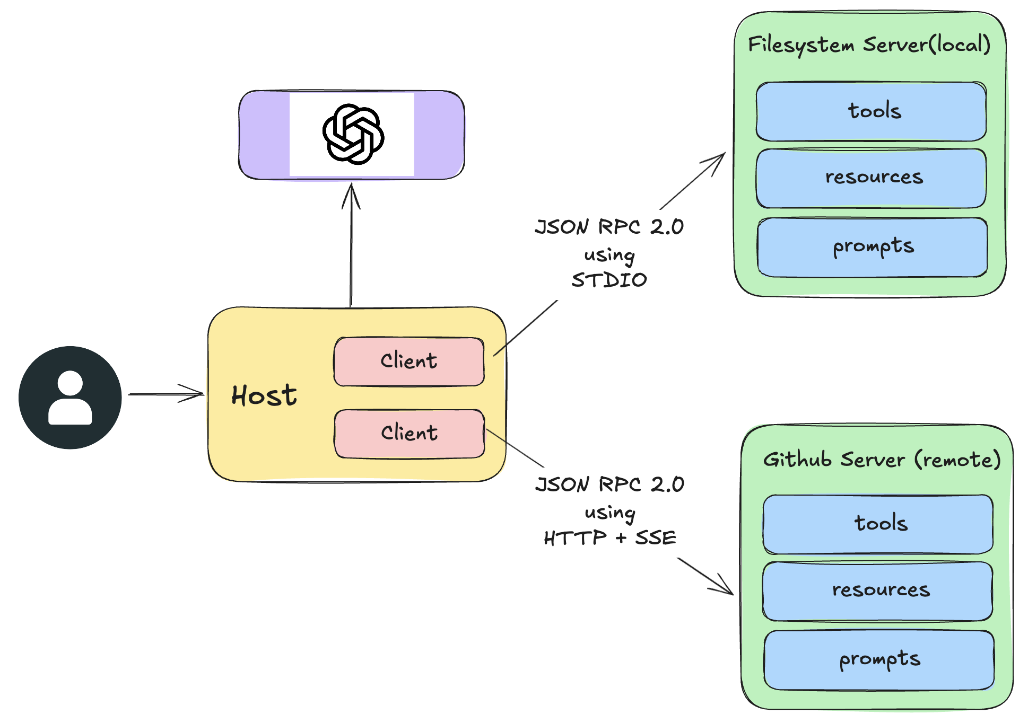

Slide 60
MCP
LIFECYCLE

Slide 61
What is MCP Lifecycle?
The MCP Life Cycle describes the complete sequence of steps that govern how a Host (client) and a Server establish, use, and end a connection during a session.

Slide 62

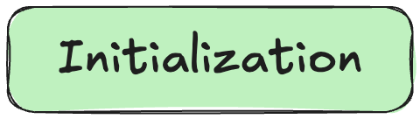
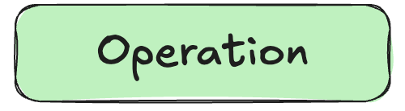
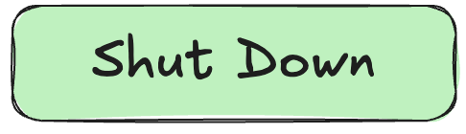
Stages of MCP Lifecycle

Slide 63
Initialization Phase
The initialization phase MUST be the first interaction between client and server.
Establish protocol version compatibility
Exchange and negotiate capabilities

Slide 64
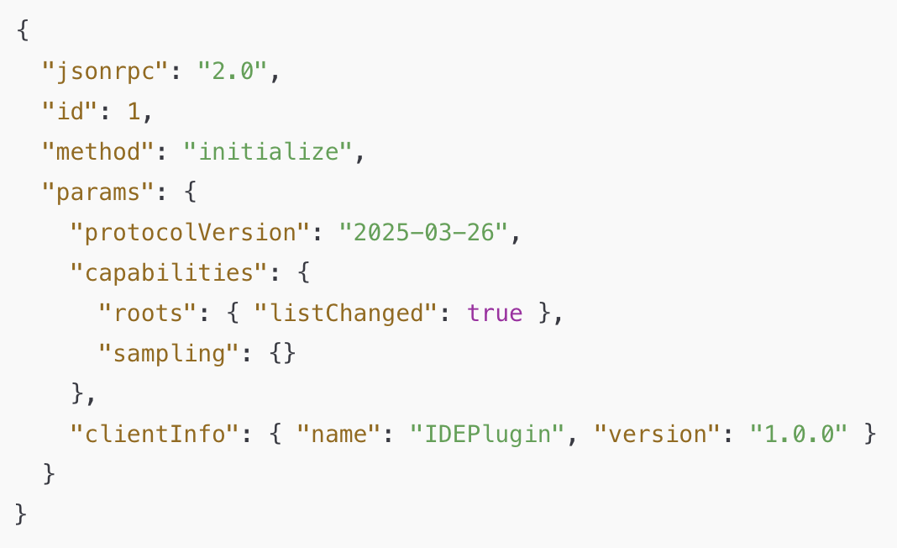
Initialization Phase - Step 1
The Client sends a initialize request containing:
MCP protocol version
Client capabilities
Client implementation info

Slide 65
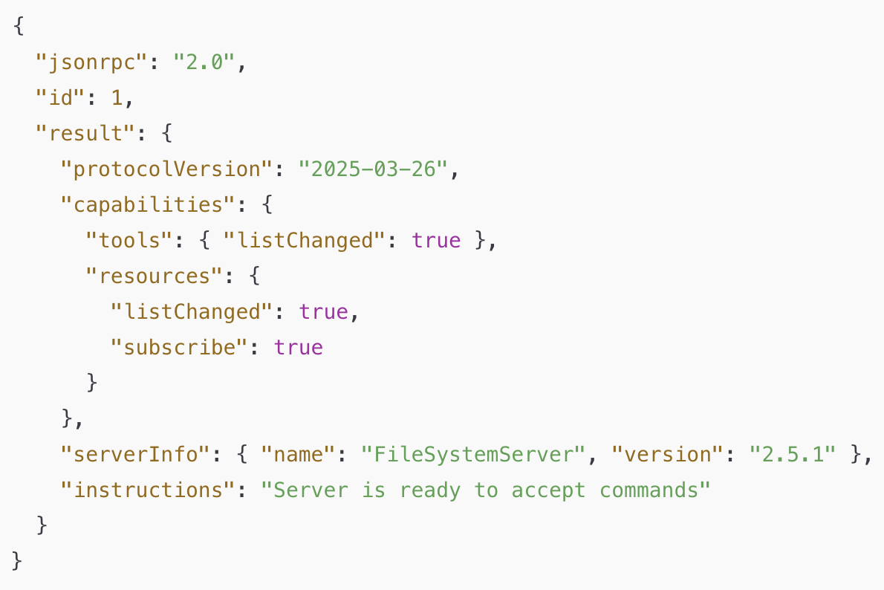
Initialization Phase - Step 2
The Server sends its own capabilities and info:
MCP protocol version
Server capabilities
Server implementation info

Slide 66
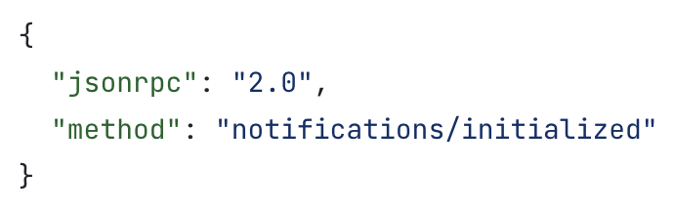
Initialization Phase - Step 3
After successful initialization, the client MUST send an initialized notification to indicate it is ready to begin normal operations:
Now the Client and Server are connected

Slide 67
Important Rules
The client SHOULD NOT send requests other than pings before the server has responded to the initialize request.
The server SHOULD NOT send requests other than pings and logging before receiving the initialized notification.

Slide 68
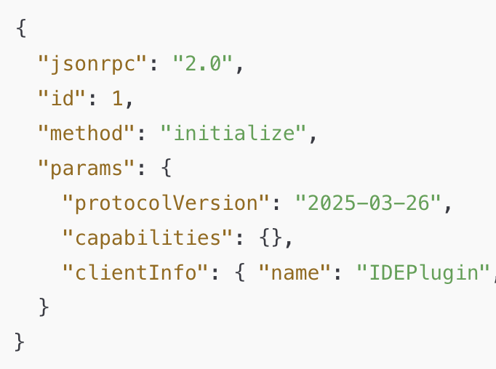
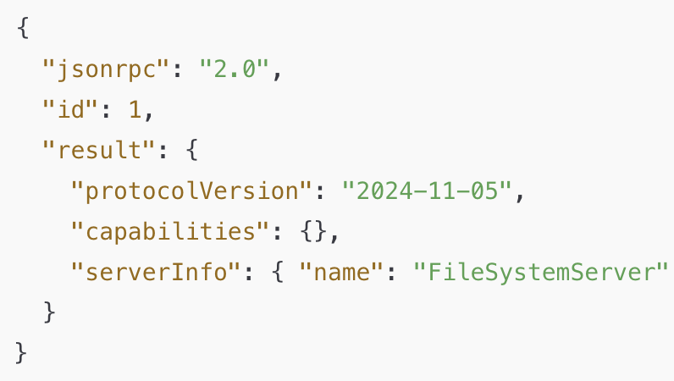
Version Negotiation

Slide 69
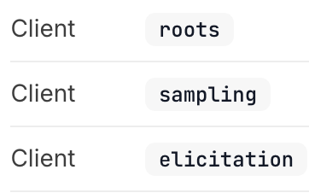
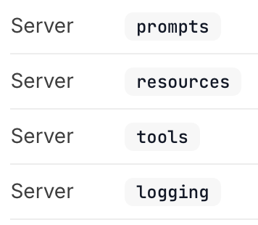
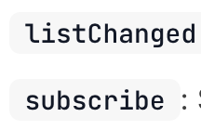
Capability Negotiation
Client and server capabilities establish which protocol features will be available during the session.
Sub-capabilities

Slide 70
Operation Phase
During the operation phase, the client and server exchange messages according to the negotiated capabilities.
Respect the negotiated protocol version
Only use capabilities that were successfully negotiated

Slide 71
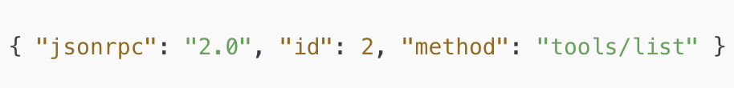
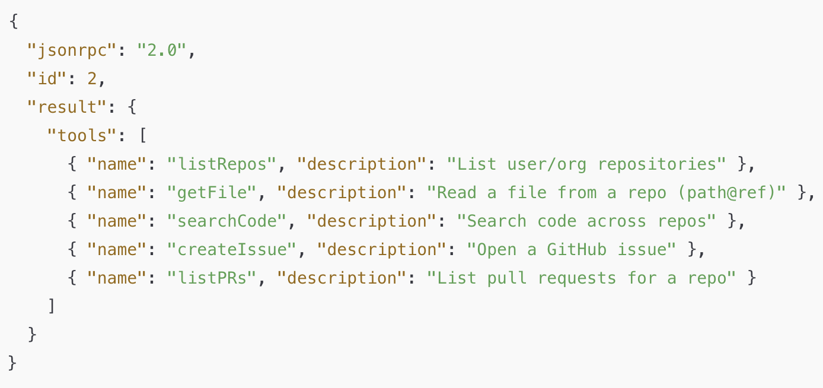
Capability Discovery

Slide 72
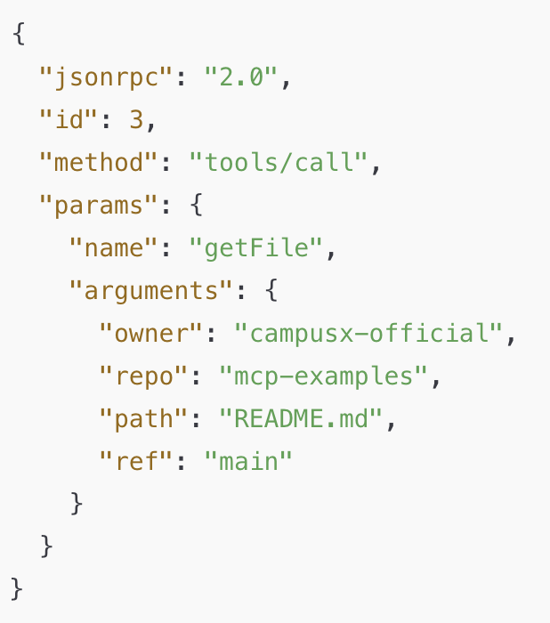
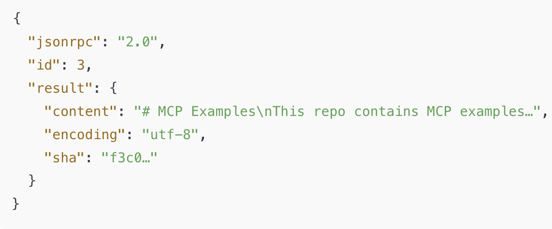
Tool Calling

Slide 73
Shutdown Phase
One side (typically the client) initiates shutdown
No special JSON RPC shutdown message is defined
Transport layer is responsible for signaling termination

Slide 74
Shutdown in STDIO
Client-initiated shutdown (SHOULD):
Close input stream to the child process (server)
Wait for server to exit
Send SIGTERM if server does not exit in time
Send SIGKILL if still unresponsive
Server-initiated shutdown (MAY):
Close output stream to the client
Exit process

Slide 75
Shutdown in HTTP
Client-initiated shutdown (common case):
The client (Host) closes the HTTP connection(s) it opened to the Server.
Server-initiated shutdown (possible):
The server may close the connection from its side
The client must be prepared to detect a dropped connection and handle it (e.g., reconnect if appropriate).

Slide 76
SPECIAL
CASES

Slide 77

Pings
Ping is a lightweight request/response method defined in MCP.
Purpose: to check whether the other side (Host or Server) is still alive and the connection is responsive.

Slide 78
When is Ping used?
Useful for checking if the other side is up before full initialize.
If there’s no activity for a while, a client may send periodic pings. Prevents the connection from being dropped silently by the OS, proxies, or firewalls.

Slide 79
Error Handling
Error handling in MCP is how the Host (client) and Server signal that something went wrong with a request
MCP inherits JSON RPC’s standard error object format
Causes of Error
Unsupported or mismatched protocol version.
Internal server failure while processing a request.
Calling a method for a capability that wasn’t negotiated.
Timeout exceeded → client cancels request.
Invalid arguments to a tool
Malformed JSON-RPC messages.

Slide 80
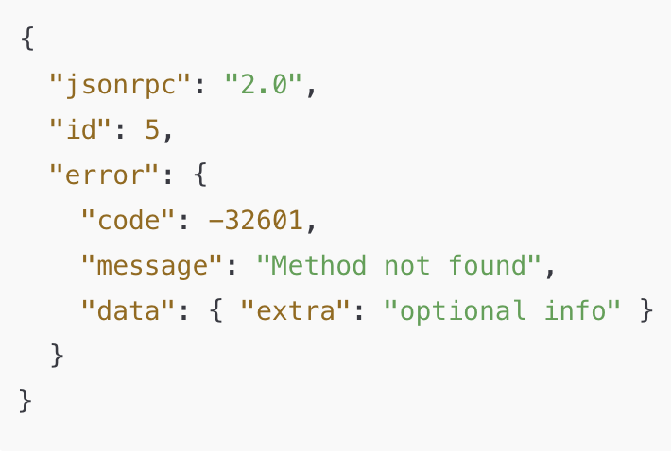
Error Object Structure
code → integer code that categorizes
the error.
message → short human-readable
explanation.
data → (optional) extra structured data for debugging or context.

Slide 81
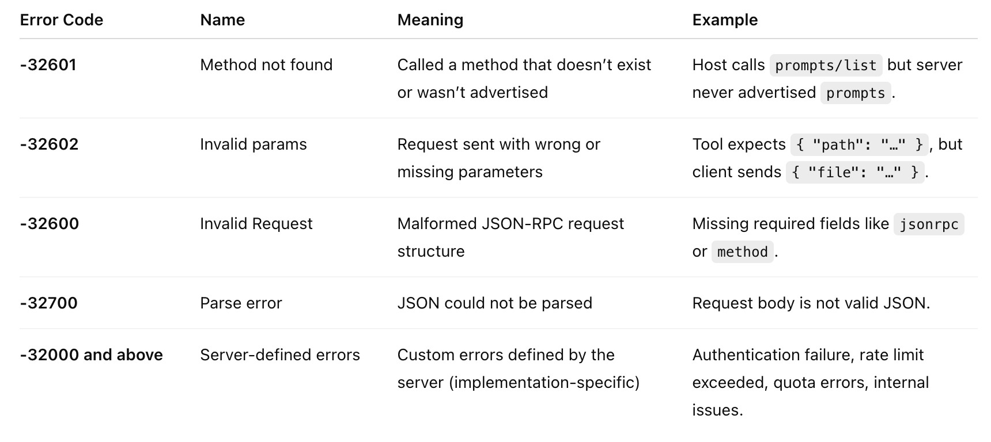
Common Error Codes

Slide 82
Timeout
Timeout is about ensuring requests don’t hang forever
Purpose
How Timeout Works
Protects against unresponsive or overloaded servers.
SDKs let Client sets a per-request timeout (e.g., 30s).
Ensures resources (memory, CPU) aren’t held indefinitely.
If the deadline passes with no result → client triggers a timeout.
Gives the user feedback instead of waiting forever.
Client then sends a cancellation notification to tell the server to stop.
The server must stop processing that request and not return a result.

Slide 83
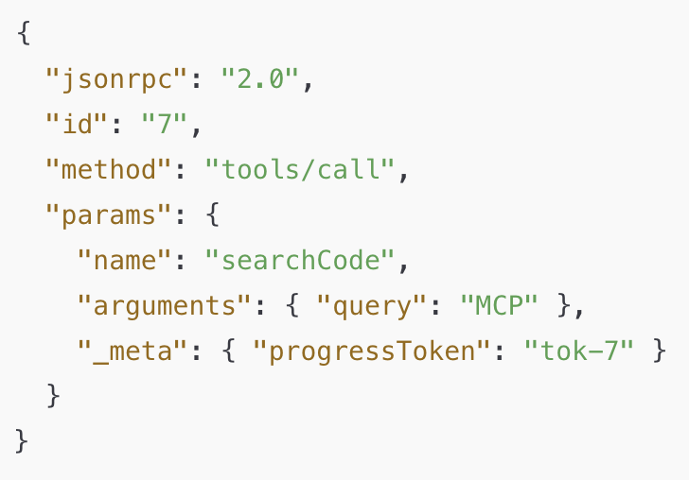
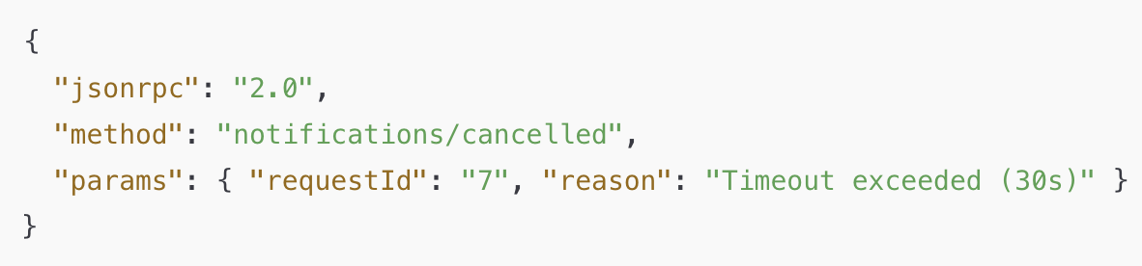
Cancellation

Slide 84
Progress Notification
Purpose: Let the client know a long-running request is still making progress.
Client includes a progressToken in the request’s _meta.
Server can then send notifications/progress updates while working.

Slide 85
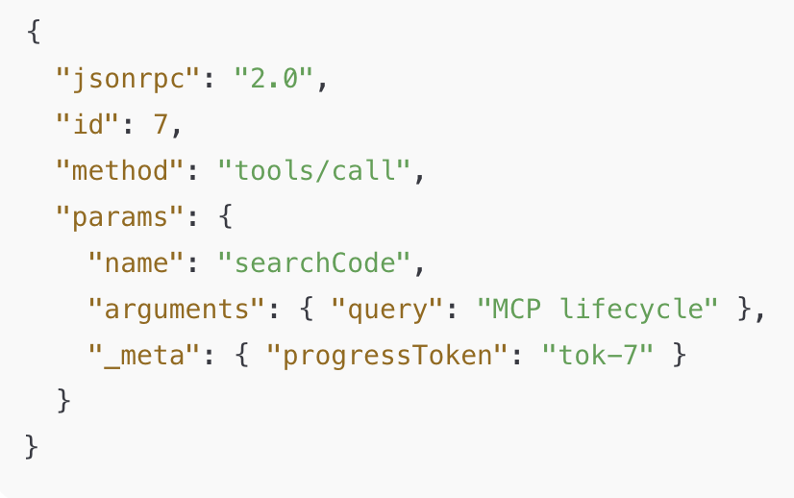

Progress Notification

Slide 86
THE
HOW

Slide 87


Strategy
Ready made client like Claude Desktop
Already
Existing servers like
Google Drive
Claude Desktop
Our own
MCP Server
Our own
MCP Client
Our own
MCP Server

Slide 88





Plan of Action
Claude Desktop
Local Servers
Remote Servers

Slide 89
Type of Connections
Using Config File
Using Connectors

Slide 90
What are Connectors?
A Connector is a built-in feature that links Claude to MCP servers automatically, without the need for manual setup or configuration.
Most Claude Desktop users are non-technical end-users who just want Claude to “talk” to their apps (Notion, Google Drive, GitHub, Slack, etc.).
They don’t want to run servers, edit JSON, or worry about transports.
The Connector system wraps an MCP server behind the scenes and handles authentication via OAuth (sign-in with Google, GitHub, etc.).
This keeps things easy, safe, and consistent.
Think of Connectors as the “App Store” for MCP servers — user-friendly, click-based, pre-curated.

Slide 91
Why not use Connectors always?
Connectors Are Curated & Managed
Connectors are officially built, hosted, and maintained by Anthropic
They come with OAuth login flows, managed security, rate-limits, and guaranteed stability.
If every MCP server were required to be a Connector, it would mean Anthropic has to review, host, and secure every possible server — which doesn’t scale
MCP is an Open Standard
MCP is designed so anyone can write a server
Forcing everything through Connectors would close the ecosystem and make you dependent on Anthropic to approve or publish servers.
Notes:
The config file path exists to preserve freedom and extensibility

